Slide 1
Why computer science needs philosophy
Barry Smith
National Center for Ontological Research

Slide 2
Shimon Edelman’s
Riddle of Representation
two humans, a monkey, and a robot are looking at a piece of cheese;
what is common to the representational processes in their visual systems?

Slide 3
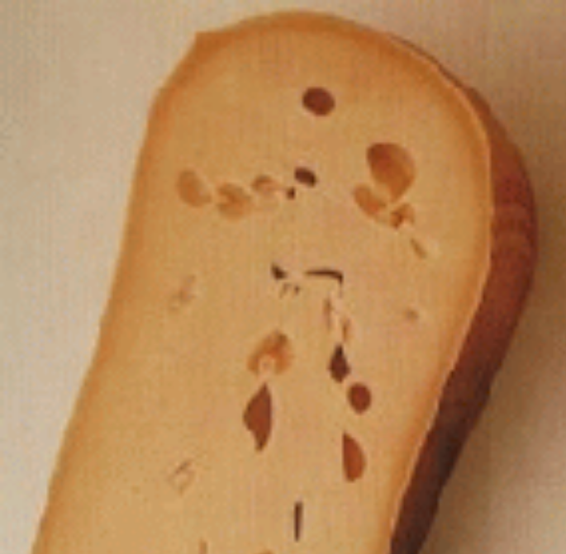
Answer:
The cheese, of course
Notes:
With thanks to Shimon Edelman. See http://www.ai.mit.edu/~edelman/archive.html

Slide 4
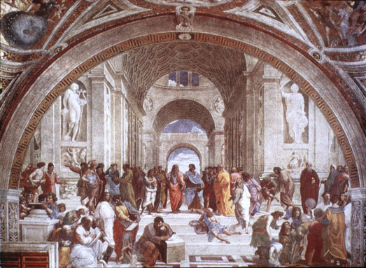
the prehistory of science

Slide 5
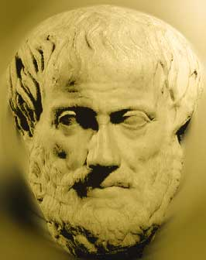
There is no problem of the unity of science
because all science can be stored inside one person’s head

Slide 6



The era of empiricism
If two scientists disagree they resolve their disagreement by examining reality

Slide 7
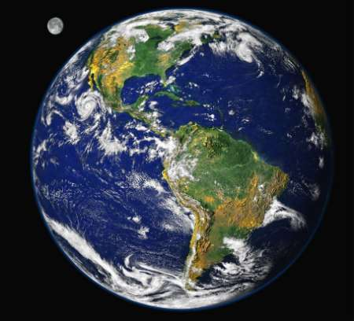
The problem of the unity of science is solved by reality itself

Slide 8




the brief logical positivist interlude

Slide 9
A science is a collection of propositions
(Bolzano: each science is identified with an ideal scientific textbook)
The problem of the unity of science is a problem of logic

Slide 10

The new age of science

Slide 11
A science is a collection of databases and associated algorithms
The problem of the unity of science is a problem of computer science

Slide 12
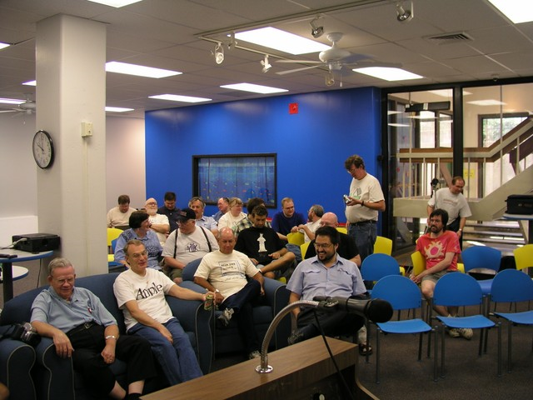
011011101010001000100010010010010010010001001111001001011011110110111011
011011101010001000100010010010010010010001001111001001011011110110111011
011011101010001000100010010010010010010001001111001001011011110110111011

Slide 13
011011101010001000100010010010010010010001001111001001011011110110111011
011011101010001000100010010010010010010001001111001001011011110110111011
011011101010001000100010010010010010010001001111001001011011110110111011

Slide 14
To solve the problem of the unity of science, what we need is an ‘information model’

Slide 15
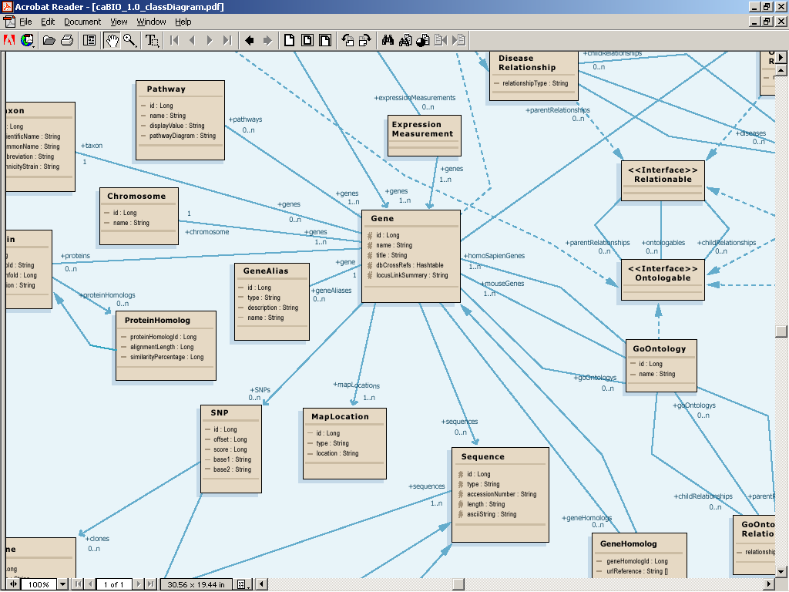
caBIO Design Artifacts – UML Class Diagrams

Slide 17
The new age of science

Slide 18
The new age of science

Slide 19
The new age of science

